Slide 1
Investigating time series neural data: Experimental design & processing Dr Saugat Bhattacharyya

Slide 2
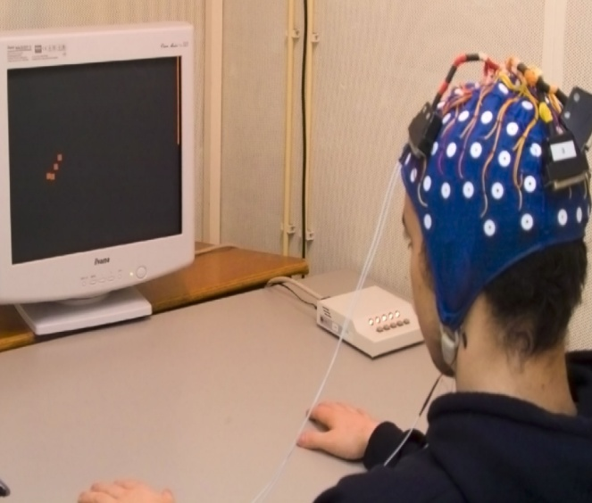
EEG Recording
The neuronal firing inside the brain generates electrical signals.
These electrical signals picked up from the scalp by metallic electrodes are called EEG signals.

Slide 3
EEG as a Weighted Sum of Independent Neuronal Signals
X₁(t)
X₂(t)
Y₁(t)
EEG is presumed to be a linear combination of independent intra-cortical source signals.
An EEG
X₃(t)
Y₁(t) = w₁₁ X₁(t) + w₂₁ X₂(t) + w₃₁ X₃(t)
External electrode
Sources
Firing neuron
Inactivated neuron

Slide 4
EEG/MEG: Non-Stationarity
Because of asynchronous firing of the neurons over time, the frequency content of an EEG changes with time. This is why EEG is called a non-stationary signal.
Neurons
Elect.
Temporal changes in firing status of neurons
Firing neuron
Inactivated neuron

Slide 5
EEG/MEG: Non-Gaussian
An EEG
Suppose the intra-cortical sources are independent, and each of them (over time) has a mean M and variance s².
Suppose EEG Y₁(t) = (X₁(t) + X₂(t) + X₃(t))/3.
Then in order Y₁(t) to be Gaussian, with mean M and variance s²/3, we need another random variable z=(Y₁ –M)/s/√3 to be Gaussian with mean 0 and variance 1.
However, no such z exists, and so EEG is not Gaussian.
X₁(t)
X₂(t)
Y₁(t)
X₃(t)
External electrode
Independent Intra-cortical electrodes

Slide 6
EEG/MEG: Non-Linear
If Y(t_{n}) = a₀ Y(t₀) + a₁ Y(t₁) +….+a_{n-1} Y(t_{n-1}) then Y(t) is a linear signal.
Because of asynchronous firing of neurons, the amplitude at any time t of an EEG is random within a given bounds limited by bounded power level of the neurons.
So, the linearity condition given in (1) fails, and so EEG is non-linear.
Y(t)
t₀
t_{n-1}
t_{n}
EEG

Slide 7
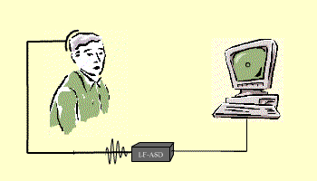
Brain-computer interfacing?
“ A Brain-Computer Interface is a communication system that do not depend on peripheral nerves and muscles” [Wolpaw et al. 2000]
A technology which allows a human to control a computer, peripheral, or other electronic device with thought.
http://www.ece.ubc.ca/~garyb/BCI.htm

Slide 8
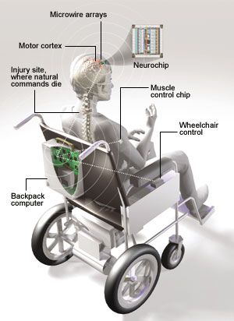
Motivation
is to give disable people to communicate, to operate prostheses, and even to operate wheelchairs using brain signals.
Target group:
Amyotropic Lateral Sclerosis
Cervical spinal injury
Stroke paralysis
Celebral palsy
Amputee, etc
Nicolelis, 2001

Slide 9
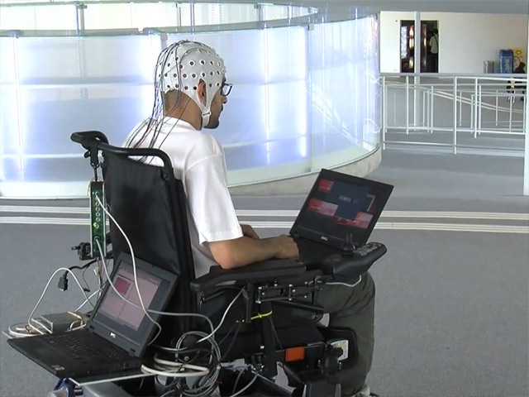
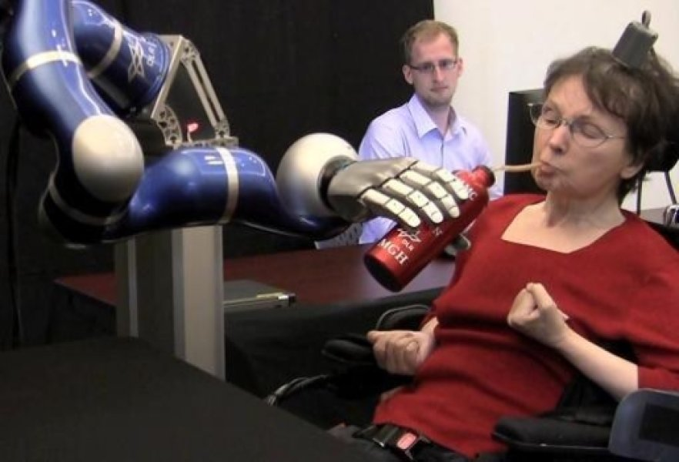
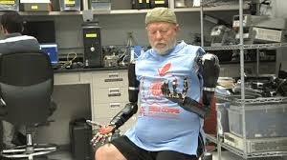
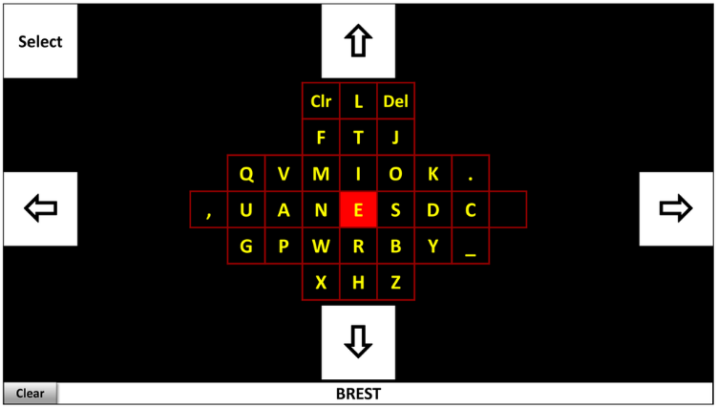
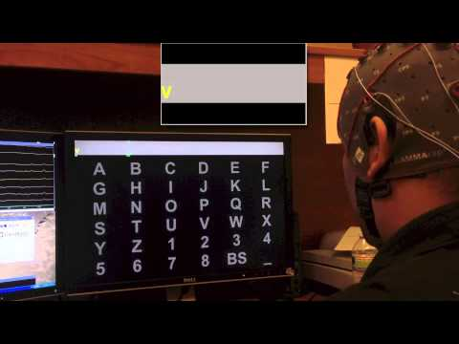
BCI in Rehabilitation
1. Thought Controlled Wheelchair
2. Upper Limb Prosthesis
3. Cursor Control
4. Virtual Keyboard
5. BCI Speller

Slide 10
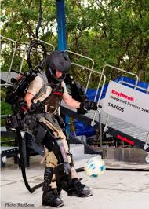
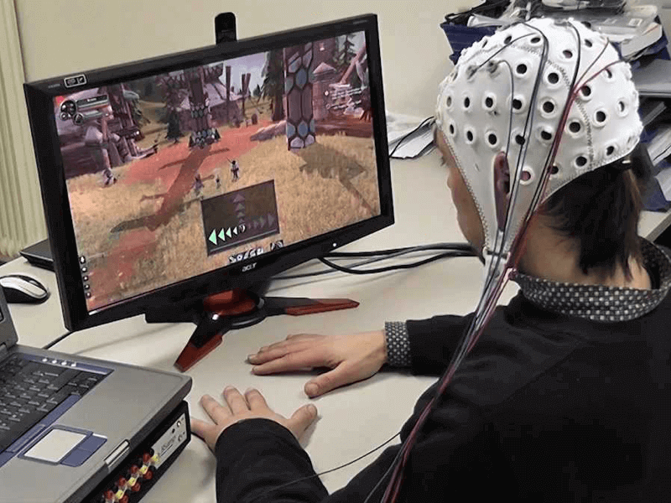
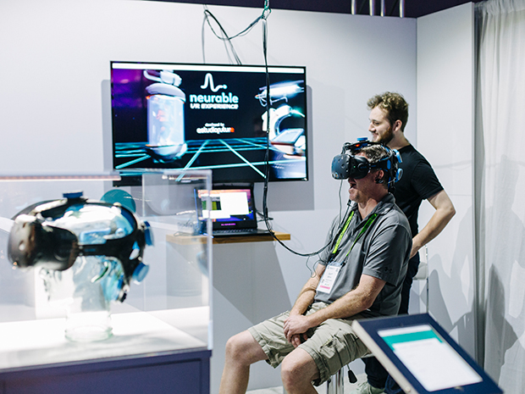
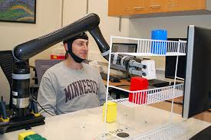

BCI in Everyday Life
https://emotiv-website-uploads-live.s3.amazonaws.com/uploads/2019/05/bci-gaming-world-of-warcraft-1.png
https://www.army-technology.com/features/featurebrain-computer-interfacing-military-mind-control/attachment/featurebrain-computer-interfacing-military-mind-control-4/
https://www.ireviews.com/content/uploads/2017/08/7.jpeg
https://cdn.thenewstack.io/media/2016/12/ac3d5887-brain-computer-interface-robotic-arm-1.jpg
https://cakedigit.com/wp-content/uploads/2017/01/coca.png

Slide 11
Common Neural Signals

Slide 12
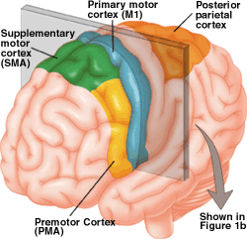
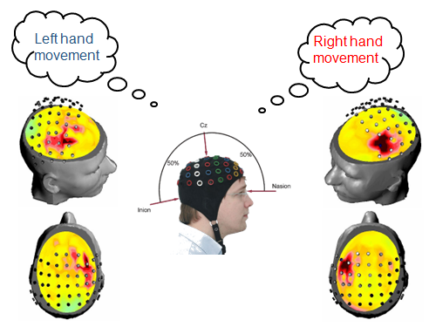
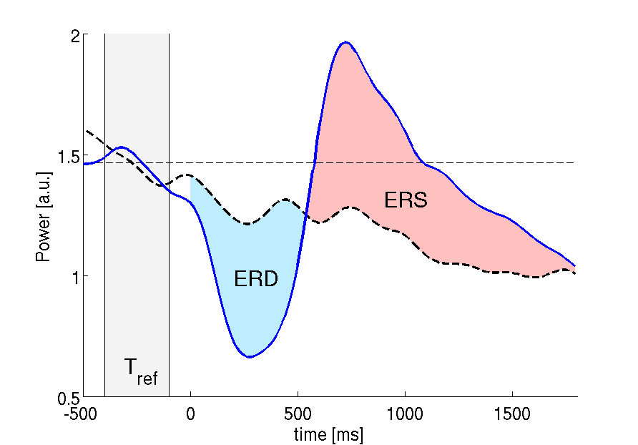
Motor Imagery (ERD/ERS)
Rolandic mu rhythm (8-12 Hz) and the central beta rhythm (16-24 Hz)
Movement Imagination/Execution
Notes:
Motor imagery is a cognitive process in which a subject imagines that he/she performs a movement without performing the movement and without even tensing the muscles.
It is a dynamic state during which the representation of a specific motor action is internally activated without any motor output.
In other words, motor imagery requires the conscious activation of brain regions that are also involved in movement preparation and execution, accompanied by a voluntary inhibition of the actual movement.
They are usually characterized by sensorimotor rhythms.

Slide 13
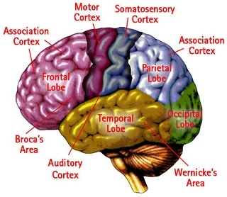
Slow Cortical Potential Operant Conditioning
Example: Moving cursor up and down causes a respective growth and fall off in SCP signal.
SCP
Moving Dn.
Moving up
Cursor control
SCP
Notes:
Slow cortical potentials are negative or positive polarizations of the electroencephalogram (EEG) or magnetic field changes in the magnetoencephalogram (MEG) that last from 300 ms to several seconds.
Functionally they constitute a threshold regulation mechanism for local excitatory mobilization indicated by negative slow potentials or inhibition indicated by positive slow potentials of cortical networks. Humans can learn to voluntarily regulate these potentials after operant training using immediate feedback and positive reinforcement for self-generated slow potentials shifts. After learned self-regulation of negative slow cortical potentials, motor and cognitive performance of various tasks improves, depending upon the specific cortical location of the learned response.

Slide 14
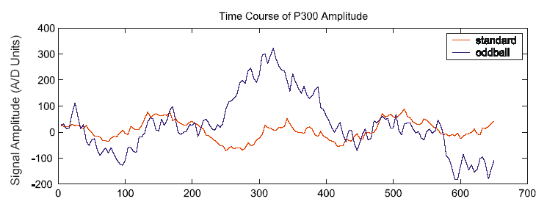
P300
Event-related potential (ERP) associated to the presence of uncommon targets or infrequent stimuli to which a user is paying attention
Notes:
The P300 is a positive deflection in the electroencephalogram (EEG) time-locked to auditory or visual stimuli.
It is typically seen when participants are required to attend to rare target stimuli presented within a stream of frequent standard stimuli (oddball paradigm).
The P300 amplitude varies as a function of task characteristics such as discriminability of standard and target stimuli, loudness of tones, overall probability of the target stimuli, the preceding stimulus sequence, and the electrode position.
Mostly observed in central and parietal regions, it is seen as a correlate of an extinction process in short-term memory when new stimuli require an update of representations.
As early as the late eighties, Farwell and Donchin had shown that the P300 component of
the event-related potential can be used to select items displayed on a computer monitor
Rapid Serial Visual Presentation
In the RSVP paradigm, the latency and amplitude of P300 components may vary with different experimental parameters [8], such as target probability and stimulus semantics.

Slide 15
Steady-State Visual Evoked Potential
SSVEP: The amplitude of the response is modulated by the frequency of the stimulus.
SSVEP
Input video stimulus
Stimulus
High Freq.
SSVEP
EEG electrode
Notes:
After visual stimulation, evoked potentials can be recorded from the visual cortex in the occipital lobe (O1, O2, Oz).
A visually evoked potential becomes steady if the presentation rate of stimuli is above 6 Hz
When participants focus their gaze on a flickering target, the amplitude of the steady-state visually evoked potential (SSVEP) increases at the fundamental frequency of the target and second and third harmonics
Amplitude and phase of the SSVEP depend on stimulus parameters such as repetition rate and contrast.
Like the P300-BCI, the SSVEP-BCI requires attention and intact gaze but no user training as the cortical response is elicited via external stimulation. To elicit SSVEPs, targets with different flickering frequencies are presented on a monitor or on a board with light emitting diodes (LED)

Slide 16
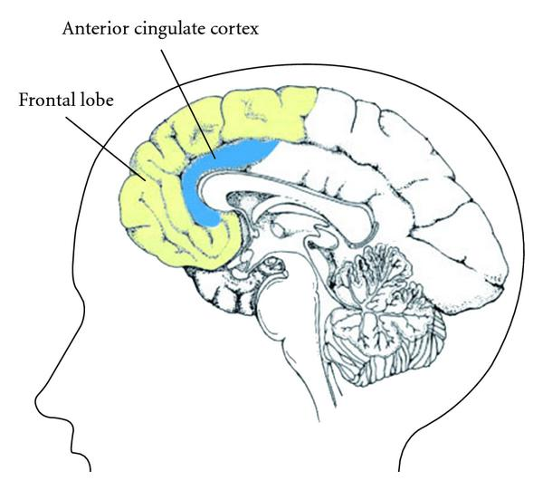
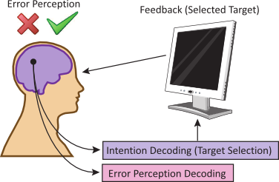
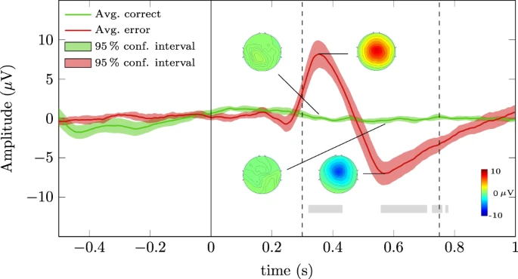
Error Related Potential
User’s awareness to erroneous response.
Typical occurrences that elicits ErrP:
Choice reaction tasks
Feedback tasks
Observation tasks
Lopes-Dias et al., Sci. Rep., 2019
* Spuler, et al., Frontiers Human Neuroscience, 2015
Notes:
Error-related potentials (ErrPs) are the neural signature of error processing. Therefore, the detection of ErrPs is an intuitive approach to improve the performance of brain-computer interfaces (BCIs).
It is the user’s awareness of the committed mistake.

Slide 17
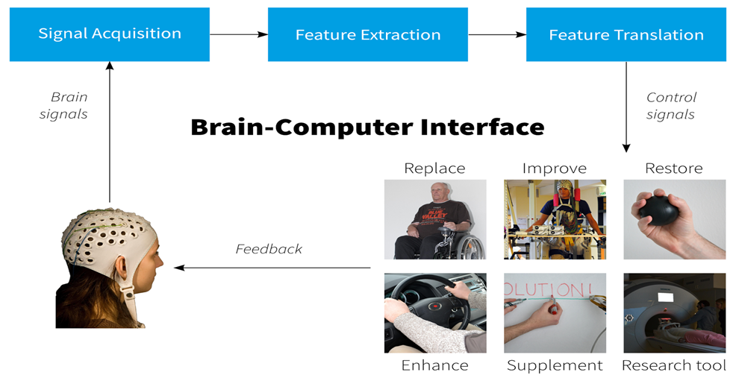
Basic Pipeline

Slide 18
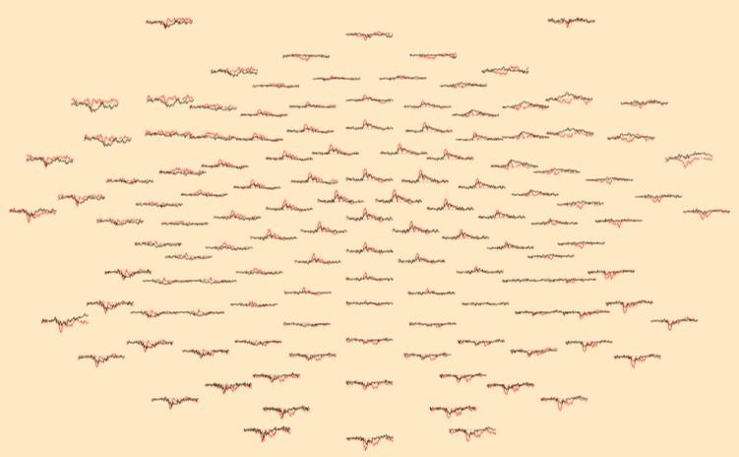
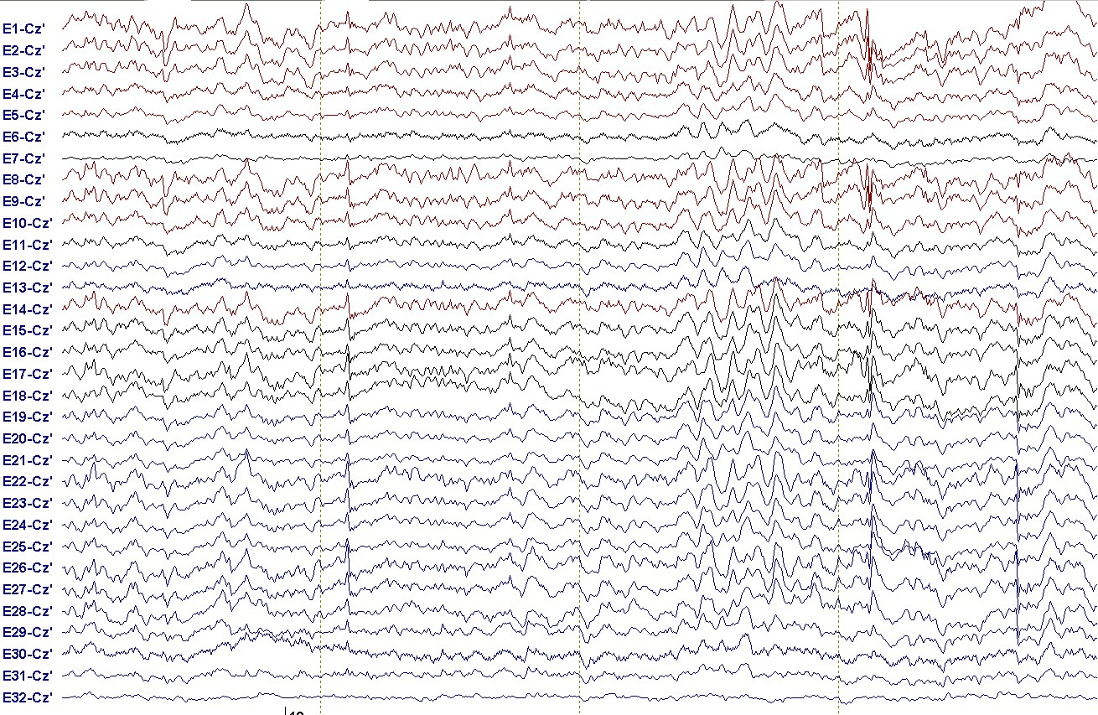
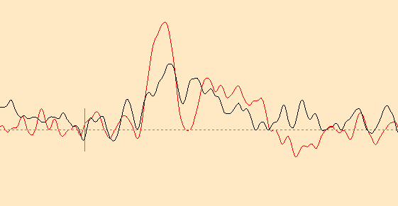
Event Related Potential
Averaged across 100 stimulus presentations
EEG
ERP at a single electrode
Notes:
Event-related potentials (ERPs) are electrocortical potentials that can be measured in the EEG before, during, or after a sensory, motor, or psychological event. They have a fixed time delay to the stimulus and their amplitude is usually much smaller than the ongoing spontaneous EEG activity
They are less frequent than the spontaneous EEG waves with similar shape and amplitude
To detect ERPs, averaging techniques are used.
Signal averaging is a signal processing technique applied in the time domain, intended to increase the strength of a signal relative to noise that is obscuring it.
a number of EEG segments, each time-locked to the same class of event, are averaged to give a waveform in which consistent features of the segments (the ERP) are retained while features that vary across segments are attenuated.

Slide 19
Event Related Potential
ERP-averaging is based on the following assumptions: (Regan, 1989)
The background EEG acts as noise for the ERP-signal
The signal waveform is generated by a process that stays stationary
from trial to trial
The noise, background EEG, is produced by a stationary random process
The noise samples are uncorrelated from trial to trial
Possible problems:
The background EEG is not always random in relation to stimuli.
e.g. 50 Hz electric current can create a regular rhythm to the background EEG.
A psychological process, reflected in ERP-signal, may not remain the
same during the entire measurement session, e. g. due to arousal
state effects

Slide 20
Stimulus-Locked & Response-Locked ERPs
Stimulus-Locked
Response-Locked

Slide 21
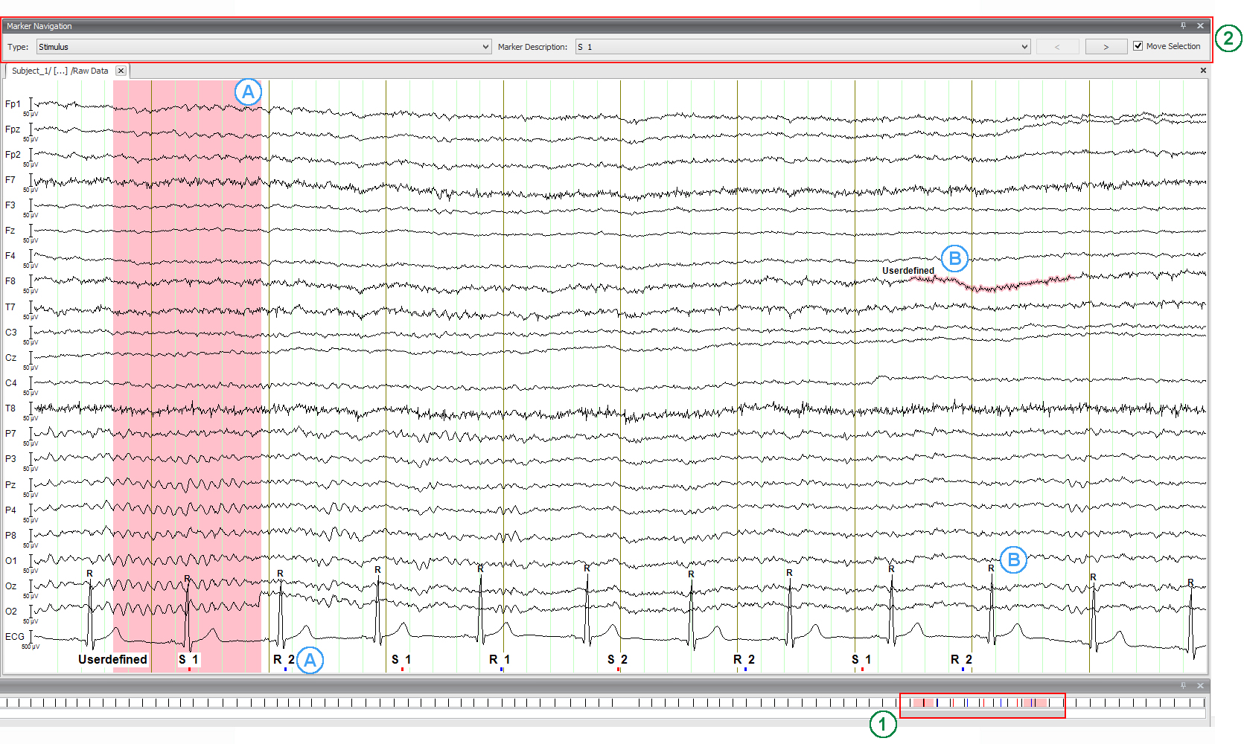
Designing Experiments
Do not underestimate the importance of good experiment design
Produce meaningful and interpretable results
Implications for theories
Inspire new research
Pilot test your experiment behaviourally
Event Markers
Triggers that are sent from stimulus delivering computer to the EEG amplifier
Recorded as separate channel
Encode specific events such as stimulus onset or responses, etc.
https://pressrelease.brainproducts.com/wp-content/gallery/1602_ST/GUI_NavigationBar_Markers.jpg
Notes:
Triggers are square-wave pulse ….
The amplitude of the pulse is used to encode specific events such as stimulus onset or response.
They are critical because they are used to time-lock the EEG data offline. They are also used to re-construct different conditions and responses. Therefore, it is always better to have markers encode too much rather than two little information.
Overlapping markers. Most amplifiers do not allow multiple markers to be sent simultaneously. So when there are overlapping markers, only one gets registered.

Slide 22
Designing Experiments
Intra- and Intertrial Timing
Ideal to have experiment events within a trial separated by several hundred milliseconds
Intervals between two trials (Inter-trial intervals):
Baseline normalisation
Frequencies to analyse
Constant or Variable
Number of trials required?
Signal-to-Noise Ratio
Big the effect is
Type of analysis
Electrodes & Sampling Rate- Dependent on the type of analysis
Notes:
It is ideal to have trials separated by several hundreds of milliseconds. Partly it is due temporal smoothening introduced by time-frequency decomposition and partly because time-frequency responses may linger for hundreds of milliseconds after an experiment event has ended.
This allows the brain response of one event to subside before the response to the next event begins.
So if you do not know the electrophysiological response to a stimuli, then it is advisable to pilot the task using long durations to see how long the event lasts for.
Obviously the length of the brain response depends on the kind of task and the cognitive process that is elicited.
The duration of time between the end of one trial and the start of the next trial is called inter-trial intervals. Now while designing our experiment it is important to consider the period of time you want for baseline normalisation of task related data and at what frequency do you want to analyse them.
A tip. The baseline time period for time-frequency decomposition should end before the trial onset, approximately -500 to -200 ms. The reason being that the temporal filtering during the time frequency decomposition may cause early poststimulus activity to leak into the pre-stimulus baseline period, and this is worse at lower frequencies.
Intertrial intervals can be constant or variable. Both have advantages and disadvantages. If the intervals are constant, then the user can predict the temporal onset of the upcoming, resulting in a form of preparation signal generated at the cortical level.
If the intervals are variable, then subjects may try to guess the next trial onset, resulting in temporal expectations, surprise in the EEG.
Both behaviorial and EEG measures are affected by the duration and variability of intertrial intervals.
Subjects always tends to generate temporal expectations which affects the EEG, and so for us researchers is to constrain these expectations in the experiment or leave them unconstrained.
Sampling frequency refers to the number of times per second data are acquired from electrodes. This defines the temporal resolution of the data. The choice depends on type of analysis, the frequencies you plan to analyse and your disk space.
Remember, if you are setting the sampling frequency, you need to sample at least twice the highest frequency of interest. In practice, sample always more than twice the highest frequency you want to analyse. Having more data points per oscillation cycle increases signal-to-noise ratio and therefore allows better estimation of high frequency activities.
Sampling rate between 500 to 2000 Hz are sufficient for all analysis. 1000 is the optimal.

Slide 23
Python based packages
Numpy
Scipy
Scikit-learn
MNE-Open-source Python package for exploring, visualizing, and analyzing human neurophysiological data: MEG, EEG, sEEG, ECoG, NIRS, and more.

Slide 24
Pre-processing
Refers to any transformation or reorganisation of signals before analysing the data and after collecting the data.
Steps involved:
Filtering
Epoch extraction
Trial Rejection
Spatial Filtering
Re-referencing
Interpolating bad electrodes

Slide 25
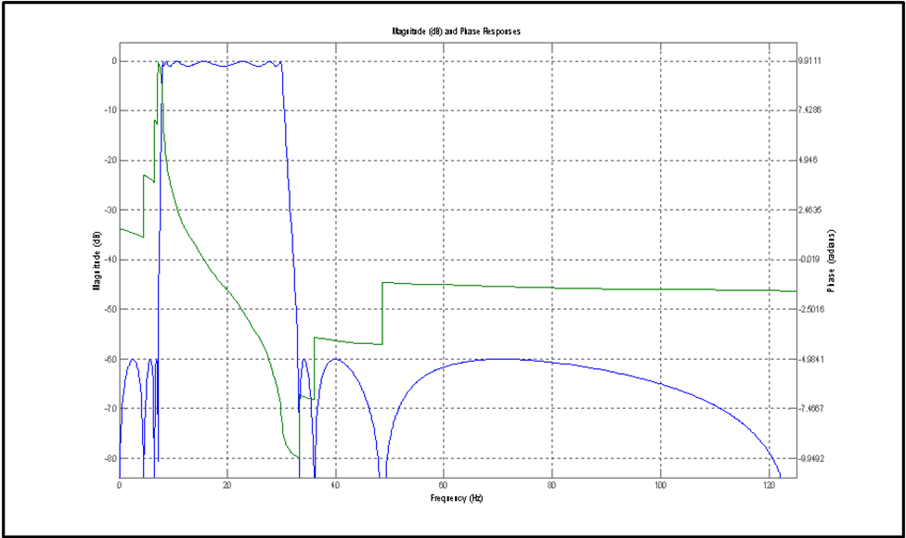
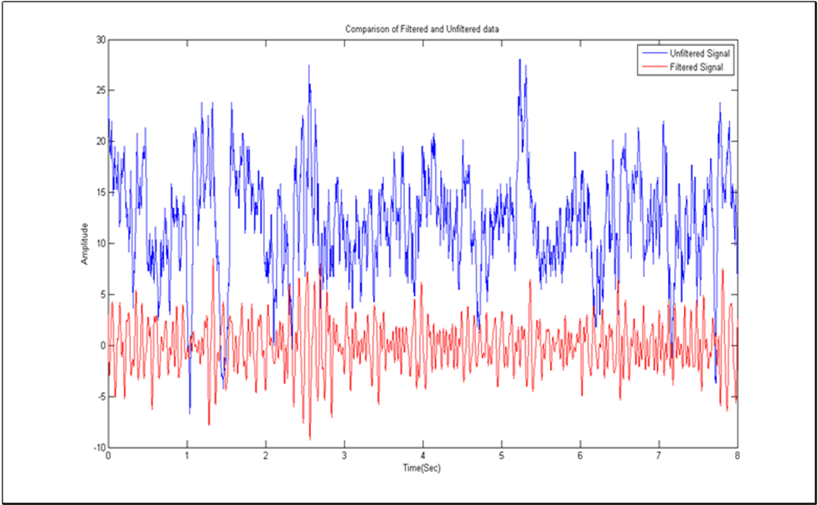
Pre-processing: Filtering
Remove high frequency artefacts, low frequency drifts
Notch filters at 50/60 Hz to attenuate electrical line noise
Recommended to apply a High-pass filter at 0.1 or 0.5Hz to minimize slow drifts
Band-pass, Band-stop, High, Low Filters
FIR and IIR filters
FIR filters are more stable; less likely to introduce nonlinear phase distortions
Computational costs higher to IIR
scipy.signal (https://docs.scipy.org/doc/scipy/reference/signal.html)

Slide 26
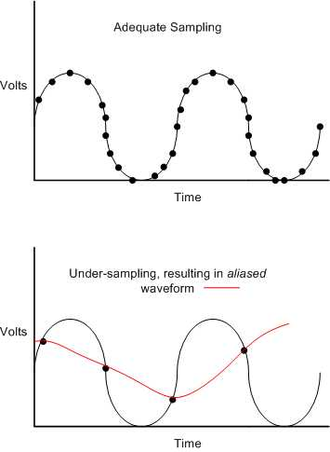
Pre-processing: Downsampling
Nyquist Theory – minimum digital sampling frequency must be > twice the maximum frequency in analogue signal
Notes:
Recording MEG/EEG involves converting the analogue signal from the brain into a series of digital representations. The EEG/MEG does not really consist of continuous data. Data are sampled at a rate specified before recording e.g. 400 samples per second. A typical EEG consists of a sequence of thousands of discrete values, one after the other.
You have to sample at a high frequencies to get a good quality digital conversions of analogue signals. The minimum sampling frequency needs to be greater than twice the maximum frequency of any analogue signal likely to be present in the EEG. This is called the Nyquist frequency. In this figure, the top picture shows well sampled data. Each dot is a digital recording of the value of the wave at each time point. Underneath, there’s an example of under-sampling. The sampling is too sparse to capture the nature of the analogue wave. With a sampling frequency that’s too low, a signal of lower frequency is generated -- this phenomenon is known as aliasing
This means you are probably going to end up sampling your data at a higher resolution than you actually need to capture you components of interest. Once your data is safely digitised, you can downsample it so that it takes up less room and is quicker to work with.

Slide 27
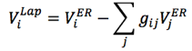
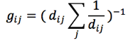
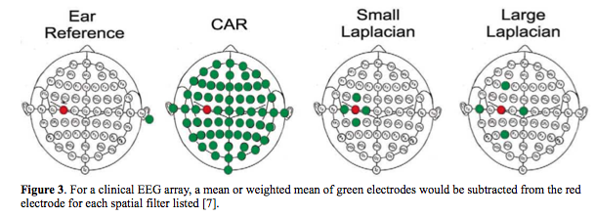
Pre-processing: Spatial Filtering
Bipolar: the voltage difference between two electrode pairs
Laplacian
Common Average Referencing (CAR)
where
McFarland, 1997
Notes:
Bipolar: While in EEG recordings often all channels are measured as voltage potential relative to a standard reference (referential recording), it also is possible to record all channels as voltage differences between electrode pairs (bipolar recording).
Laplacian: More localized signals can be obtained by a Laplace filter. In a simple approximation, Laplace signals are obtained by subtracting the average of surrounding electrodes from each individual channel
CAR: To obtain common average reference signals, the mean of all EEG channels is subtracted from each individual channel. While the influence of far field sources is reduced, CAR may introduce some undesired spatial smearing. For example, artifacts from one channel can be spread into all other channels.

Slide 28
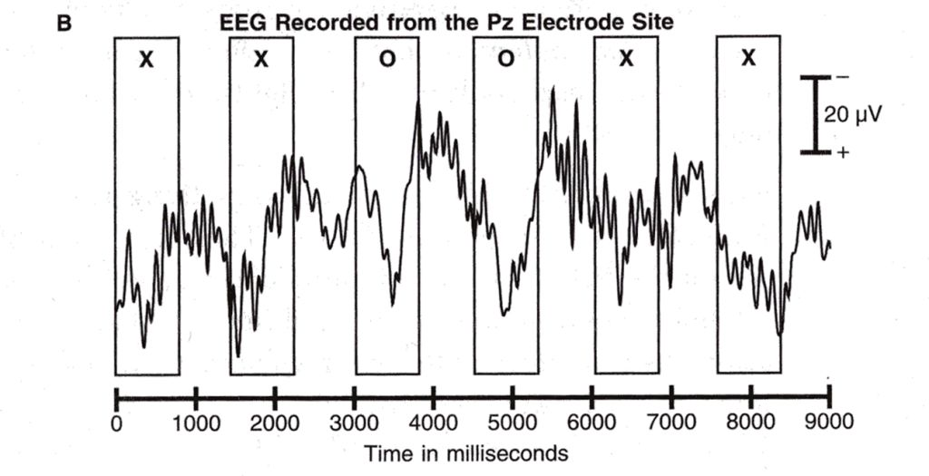
Pre-processing: Epoching
Notes:
Epoching splits the data into single trials, each referenced to stimulus presentation
For each stimulus onset, the epoched trial starts at some user-specified pre-stimulus time and ends at some post-stimulus time, e.g. from 100 ms before to 600ms after stimulus presentation.
You have to be careful with specifying your epoch timing. The epoched data is usually baseline corrected, the mean value in pre-stimulus time is subtracted from the whole trial. Essentially, you want your pre-stimulus interval to only contain noise. If there’s any activity related to the previous stimulus still around, it will be removed from the current epoch and you’ll distort your data.

Slide 29
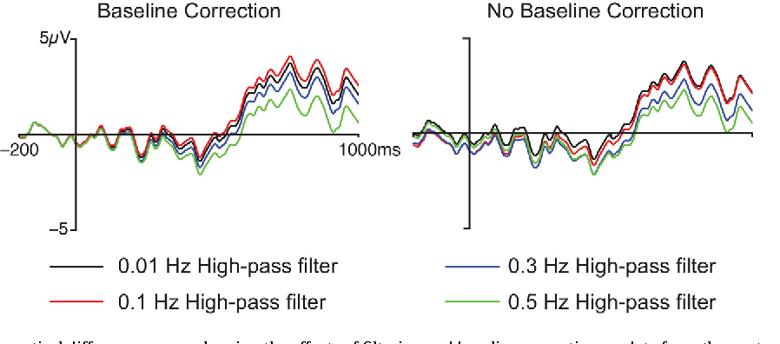
Pre-processing: Baseline Correction
Baseline correction is a linear operation because we are just computing the average of the points from the baseline period and subtracting this average from each point in the waveform.
Tanner 2016, Journal of Neuroscience Methods

Slide 30
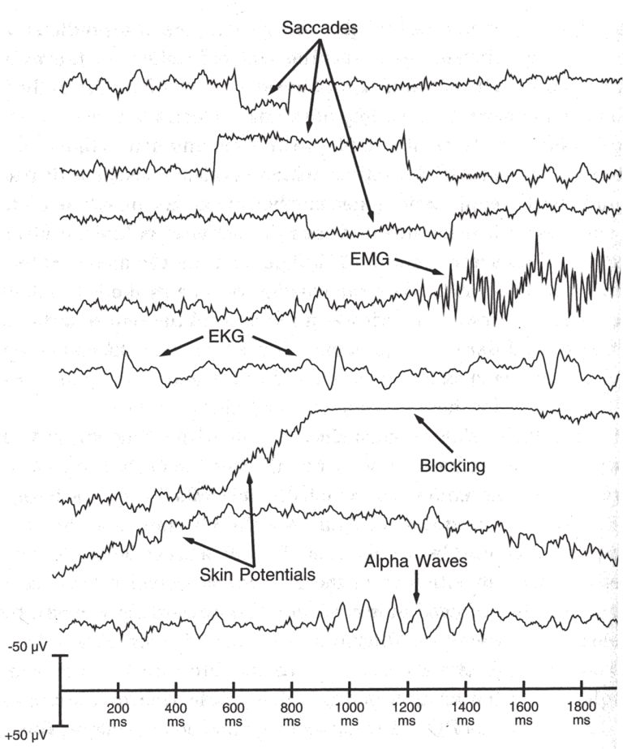
Artefact Removal
Blinks
Eye-movements
Muscle activity
EKG
Skin potentials
Alpha waves
Notes:
Some epochs will be contaminated with activity that does not come from brain processes.
Major artefacts are – eyeblinks, eve-movements, muscle activity, changes in skin impedance, alpha waves. These will all contaminate your data to some extent.
Within each eye there is an electrical gradient, positive at the front. Movement of the eyelids across the eye modulates the conduction of this electrical potential of the eyes to the surrounding regions.
Moving the eye itself actually changes the electrical gradients observable at the scalp, making them more positive in the direction the eye has moved towards. Also moves stimulus across retina, this generates unwanted visual ERPs.
Muscle activity is characterised by bursts of high frequency activity in the EEG.
EKG reflects activity of the heart. This can intermittently appear in your data
Skin potentials are only really a problem for EEG. They reflect changes in skin impedence, this could happen if the subject starts to sweat more as the experiment progresses. They look like slow drifts.. Sometimes if they drift far enough, they cause saturation of the amplifier - a flat ‘blocking’ line.
Alpha waves are actually generated by the brain. They’re slow repetitive waves of about 10 hz which are unlikely to be of any interest to you if you’re looking at cognitive processes.
So are these artefacts going to be a big problem if they appear in our data?
Short answer is that we don’t really have to worry about muscle activity. Low-pass filter will deal with muscle artefact.
Heart artefact is in a similar frequency range to ERP components, so can’t be dealt with by filtering. Luckily, usually don’t really have to worry about it as it shouldn’t appear systematically - will come and go – probably just increase overall noise levels.
Same holds for alpha waves, unless individual is particularly sleepy.
Skin potentials only appear with EEG. Again, don’t really need to worry about them as they are usually rare, slow and random. Will just add a bit of noise.
This is an important point – assuming you have a high number of trials, and your artefact is not systematically stimulus-linked, then a simple averaging procedure is surprisingly good at eliminating artefact.
Biggest problems usually are eye-blinks and eye movements. In a visual paradigm, for example, the chances are that these will be stimulus-linked. How do we deal with them?
One way to do this is by rejecting epochs which you think are contaminated by artefact. The problem here lies in recognising when things like eye-blinks have occurred. Luckily most artefactual activity is different in pattern from brain related activity, usually of a larger amplitude
This means the simple method of thresholding can be used to reject epochs in which the EEG reading shows an amplitude of above a certain amount. Alternatively, you can use eye-tracking equipment to record eye events as they occur during the experiment, and then mark these epochs as contaminated.

Slide 31
Artefact Removal
Blinking
Avoid contact lenses
Build ‘blink breaks’ into your paradigm
If subject is blinking too much – tell them
EMG
Ask subjects to relax, shift position, open mouth slightly
Alpha waves
Ask subject to get a decent night’s sleep beforehand
Have more runs of shorter length – talk to subject in between
Jitter ISI – alpha waves can become entrained to stimulus
Notes:
In practice, there are problems with both artefact rejection and artefact correction. It’s always best to try to minimize artefact in the first place.
Artefact from eye-movements becomes less important over areas further way from the eyes. With an auditory paradigm you might be justified in ignoring these artefacts.

Slide 32
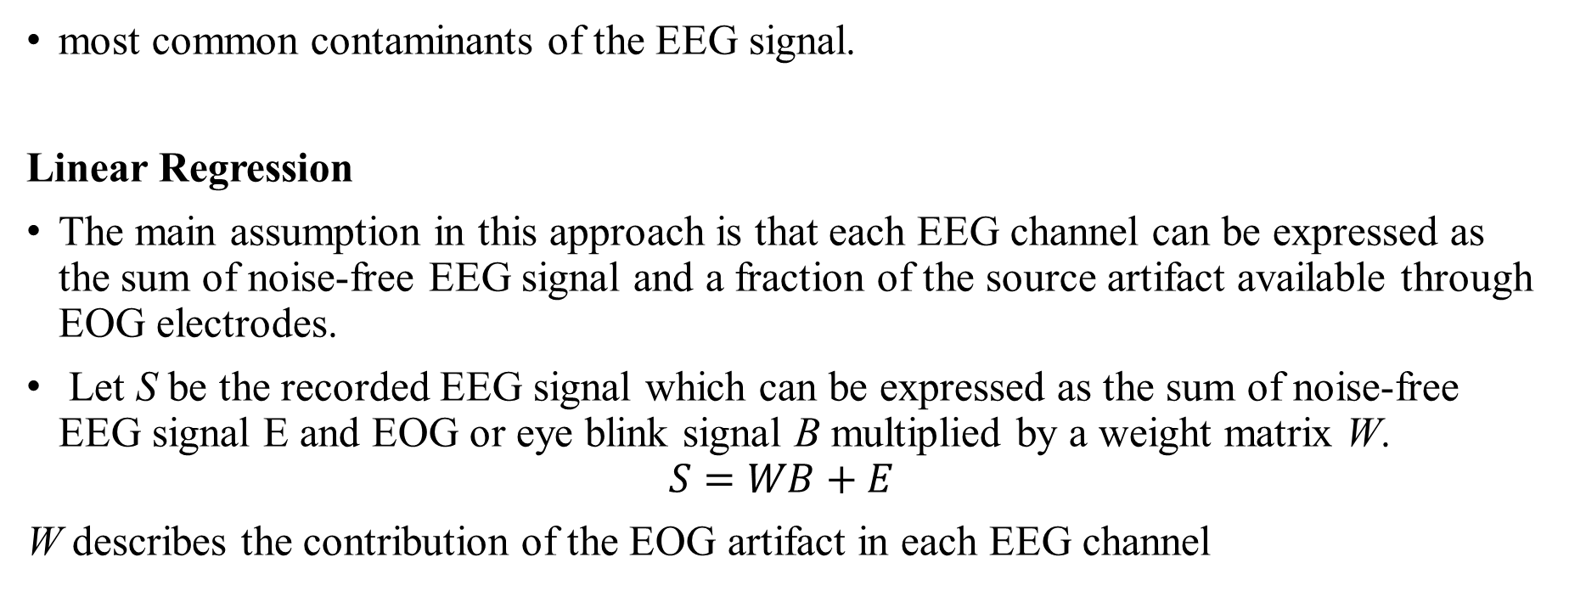
Artefact Removal-EOG/Blinks
most common contaminants of the EEG signal.
Linear Regression
The main assumption in this approach is that each EEG channel can be expressed as the sum of noise-free EEG signal and a fraction of the source artifact available through EOG electrodes.
Let S be the recorded EEG signal which can be expressed as the sum of noise-free EEG signal E and EOG or eye blink signal B multiplied by a weight matrix W.
$$S=WB+E$$
W describes the contribution of the EOG artifact in each EEG channel
Notes:
Linear regression algorithms have been commonly used to remove ocular artifacts from EEG data due to their simplicity. This approach typically requires an additional set of electrodes on the face to record electrical activity due to eye blinks and movements.
The main assumption in this approach is that each EEG channel can be expressed as the sum of noise-free EEG signal and a fraction of the source artifact available through EOG electrodes. The aim of the regression approach is then to correct the EOG artifacts by subtracting weighted portion of each EOG channel from the contaminated EEG signal.
Let S be the recorded EEG signal which can be expressed as the sum of noise-free EEG signal E and EOG or eye blink signal B multiplied by a weight matrix W.
The weight matrix W contains what is known as the regression co-efficients that describes the contribution of the EOG artifact in each EEG channel and has to be figured out and calculated somehow. Once W is known, the noise-free EEG activity is easily obtained by simply subtracting the weighted eye blink B from the signal.
The most commonly used to method to perform linear regression is the ordinary least squares (OLS) method – essentially imagine fitting a regression line using the mean squared sum of residuals through a scatter of the recorded signal on each channel vs the recorded EOG and finding its regression coefficient.
One of the major problems with this approach is the assumption that the EOG electrodes do not record any EEG activity, which is simply not true.

Slide 33
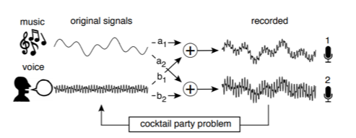
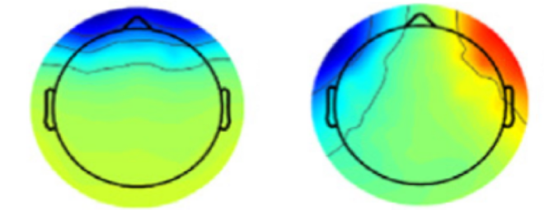
Artefact Removal-EOG/Blinks
ICA
Independent component analysis (ICA) is a blind source separation (BSS) technique that is widely used in an array of signal processing applications.
Once the components have been identified, to remove the EOG artifacts, one can visually determine which independent component corresponds to eye-blinks or movements based on the following criteria.
Presence of frontal topography (for blinks, shown on left) and bilateral with opposite sign frontal topography (for horizontal eye-movements, shown in right) in scalp map (adapted from here).
Notes:
Independent component analysis (ICA) is a blind source separation (BSS) technique that is widely used in an array of signal processing applications. ICA has become quite popular in denoising biomedical signals and is the most preferred / popular method to clean EEG data.
The intuition behind ICA is best explained using cocktail party problem. Imagine you are at a party where the music is being played and at the same time there is some speech going on (pretty bad party arrangement!). These two sources of sound, are being picked up by microphones m1 and m2. ICA assumes that the sounds s1 and s2 add up or mix linearly and the output of each microphone. The goal of ICA is to retrieve the weights and the original sounds s1 and s2.
Similarly, in the context of EEG recording, one can thing of EEG electrodes as microphones that are picking up sound from various sources like neural activity, eye activity, muscle activity etc. ICA can thus be used to disentangle these sources, which are called as independent components.
It is important to note that ICA methods makes four main assumptions – 1) Summation of sources at scalp electrodes are linear, 2) Artifacts and neural sources are spatially fixed across time, 3) Component activations are temporally independent and 4) Underlying sources are non-Gaussian. In addition, it is also assumed that the number of independent sources are at most equal to the number of recording channels.
The amount of data given to the algorithm plays an important role in ICA. As ICA is based on statistical features, results will not be reliable if the data length is short or insufficient.
Generally it is some constant times the square of channels.
Once the components have been identified, to remove the EOG artifacts, one can visually determine which independent component corresponds to eye-blinks or movements based on the following criteria.

Slide 34
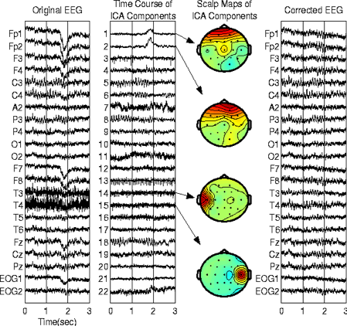
Artefact Removal-EOG/Blinks
ICA
mne.preprocessing.ICA
(https://mne.tools/stable/generated/mne.preprocessing.ICA.html)
Notes:
After identifying the components related to EOG artifacts, the corresponding column in the mixing matrix is set to zero, which essentially means zeroing the weights of EOG-related sources to all the EEG electrodes.
In the figure above (taken from here) one can see that the independent components 1 and 2 are clearly related to EOG artifacts, which is also evident from the scalp maps showing high activity in the frontal sites. Setting these components to zero gets rid of artifacts related to eye-movements as seen in the figure above.

Slide 35
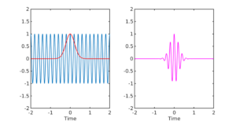
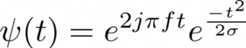
Time-Frequency Domain Analysis
Morlet Wavelet
Wavelets overcome limitations of methods such as the Fourier transform by enabling a view of changes across both time and frequency.
shape of a sinusoid, weighted by a Gaussian kernel, and they can therefore capture local oscillatory components in the time series.
Wavelets have variable resolution in time and frequency.
Notes:
Wavelets overcome limitations of methods such as the fourier transform by enabling a view of changes across both time and frequency.
Fourier transform assume the signals to be stationary (i.e. consistent in its properties across time) and compute one power spectra for the entire time window. However, it is well known that brain signals are highly dynamic and non-stationary, which means that features such as power spectra can change with time.
The figure below shows the visualization of a Mortlet wavelet obtained by multiplying a sinusoid with a Gaussian.
a wavelet is actually a complex quantity as it is obtained by multiplying a complex sinusoid with a gaussian.
TF analysis assumes that the EEG signal is stationary within the window, which can be typically in the range of few hundreds of milliseconds.
Another assumption that TF analysis makes, which is also common to standard FT analysis, is that the brain signals are sinusoidal/rhythmic in nature. While there may be rhythmic components at times, this has been challenged as a general notion

Slide 36
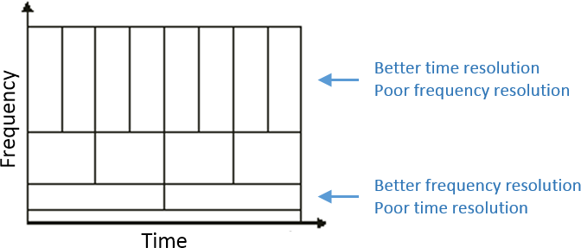
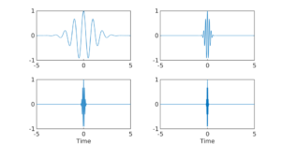
Time-Frequency Domain Analysis
Morlet Wavelet
Wavelet transformation then essentially involves convolving the complex wavelet with the EEG signal and moving it along the time axis (known as translation) and doing this with wavelets of varying frequencies (known as scaling).
higher frequency wavelets can achieve better localization in time, while low frequency wavelets lose some information in time as they are stretched out.
wavelets of frequency 1, 5, 10 and 20 Hz
Notes:
Wavelet transformation then essentially involves convolving the complex wavelet with the EEG signal and moving it along the time axis (known as translation) and doing this with wavelets of varying frequencies (known as scaling; high scale -> low frequency, low scale -> high frequency). Thus higher frequency wavelets can achieve better localization in time, while low frequency wavelets lose some information in time as they are stretched out.
As seen in the figure at the top, wavelets can provide good frequency resolution and relatively poor temporal resolution at low frequencies, while good temporal resolution and relatively poor frequency resolution at high frequencies
The figure below shows wavelets of frequency 1, 5, 10 and 20 Hz. It can be seen that as the frequency increases the wavelet becomes narrower in time!

Slide 37
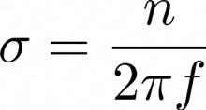
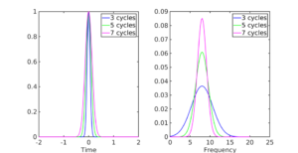
Time-Frequency Domain Analysis
Morlet Wavelet
Most important parameter-number of cycles
As the number of cycles is increased the width of the Gaussian increases.
When we take the FFT of these Gaussians, we see that the Gaussian with lower number of cycles is spread more in the frequency domain compared to the Gaussian with higher number of cycles.
Notes:
The most important parameter that affects the TF decomposition with Morlet wavelets is the number of cycles. Recall that to create a wavelet, we multiply a complex sinusoid with a gaussian and the gaussian function is defined as follows
the spread or width of the Gaussian depends on the number of cycles, via the relation
Now, let us think what happens as we vary the number of cycles for this gaussian through this plot.
As the number of cycles (n) is increased the width of the Gaussian increases (See Figure above, left). When we take the FFT of these Gaussians (Figure above, right), we see that the Gaussian with lower number of cycles is spread more in the frequency domain compared to the Gaussian with higher number of cycles. For the above examples we set f=8 Hz (i.e., the wavelet frequency) so the Gaussian with n=7 is still more concentrated around 8 Hz compared to lower values of n, but is also more spread out in time!

Slide 38
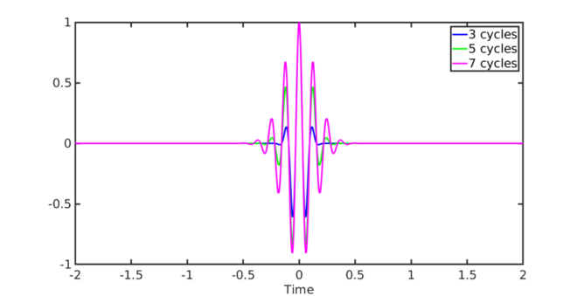
Time-Frequency Domain Analysis
Morlet Wavelet-Choosing the number of cycles (n)
the wavelet with higher n has wider spread than wavelet with lower n, which can be interpreted as poorer temporal localization as n increases.
For temporal-focussed analysis, choose lower n
For frequency-focussed analysis, choose higher n
mne.time_frequency.tfr_morlet
mne.time_frequency.tfr_array_morlet
(https://mne.tools/stable/time_frequency.html)
Notes:
the wavelet with higher n has wider spread than wavelet with lower n, which can be interpreted as poorer temporal localization as n increases.
Thus as we get more precise in frequency (with a higher number of cycles), we get more uncertain in time. The figure below shows the corresponding wavelets with number of cycles. So how does one then choose the number of cycles?
If you are more interested in what is happening temporally, for example what happens at 100 ms vs 120 ms, then choose a lower number of cycles. On the other hand, if your interest mainly lies in comparing what happens at 9 Hz vs 15 Hz, then go for a wavelet with higher number of cycles.

Slide 39
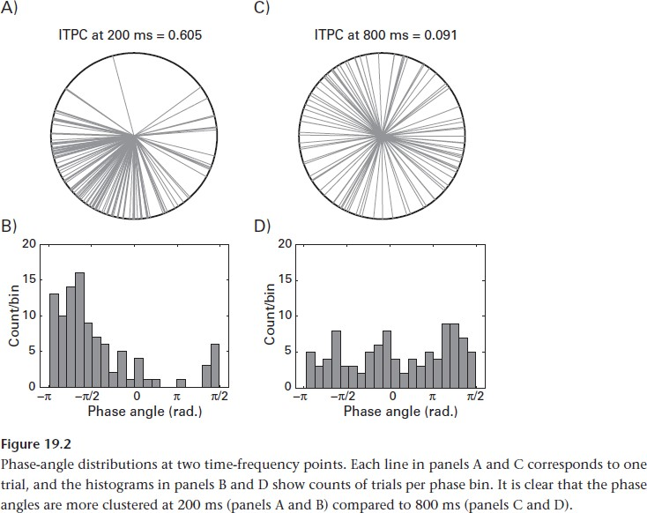
Inter-trial Phase Clustering (ITPC)
Average the activity at each time point across trials to form an event-related potential (ERP)
Average the frequency-band-specific power at each time point across trials
Phase values cannot be averaged together in the same way that voltage values or power values can be averaged
Basis for phase-based connectivity methods
Notes:
The analytic signal resulting from convolution between EEG time series and a complex wavelet such as morlet can be conceptualized as a vector in a complex polar plane.Here magnitude is the length of the vector and phase angle is the angle in radian relative to the positive real axis.
These phase angles provide information about the timing of frequency-band-specific activity.
Computing the consistency of time-frequency phase values over trials are not simple because the values cannot be averaged in the same way as we average for voltage power or frequency powers.
Why it is difficult. Phase angles are circular. 0.05 and 6.5 might seem far apart when we consider them in a line but they are actually close to each other in radian.
A population of phase angles can be represented as a population of vectors in a circle. As you can see in the figure.

Slide 40
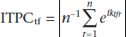
Inter-trial Phase Clustering (ITPC)
ITPC measures the extent to which a distribution of phase angles at each time- frequency-electrode point across trials is nonuniformly distributed in polar space
‘phase-locking value’, ‘phase coherence’
Measured by computing average vector, and then take the length of that average vector
Individual vectors have unit length, average vector has a length < 1
Further apart are the 2 vectors, their average length is smaller
Length of average vector reflects the closeness of the two unit length vectors
ITPC is the length
ITPC = 0 means completely uniformly distributed phase angles
ITPC = 1 completely identical phase angles
Notes:
ITPC measures the extent to which a distribution of phase angles at each time-frequency electrode point across trials is non-uniformly distributed in polar space.
You can also call them as …
ITPC is a description of the analysis rather than the interpretation of results.
The uniformity of distribution of phase angles are measured by computing the average vector and then taking the length of the vector. Note we are not averaging their phase angle here.
So an individual vector might have a length of 1 but the average vector will always have a length less than 1. So further apart the two vectors are from each other, the smaller the length of the average vector. So the length of the average vector reflects the closeness of the two unit-length vectors and ITPC is that length.

Slide 41
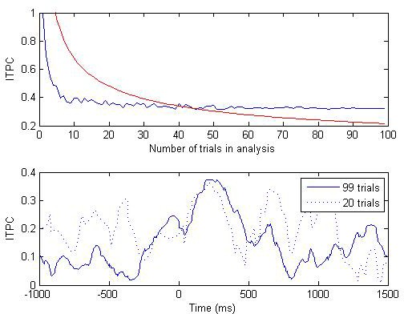
ITPC-Trial Count
Small number of trials inflates ITPC
– Especially problematic when comparing across conditions with different trial counts
~30 trials o.k.
High‐frequency activity may require even more trials
Notes:
So you can imagine that trial count influences ITPC. Also since, ITPC cannot be below 0, noise and sampling errors are more likely to increase rather than decrease ITPC, especially when there are few trials.
The figure at the top gives an example of ITPC as a function of trial count. From a total of 99 trials, random subsets of trials were selected, ITPC were calculated and then the average ITPC between 100ms and 450ms. From the top you can see that the ITPC stabilizes after 20 trials but it becomes statistically significant after 45 trials (where p < 0.01). The top figure only shows the analysis for one frequency band.
The bottom figure shows the time course of ITPC for a specific electrodes for all 99 trials and 20 randomly selected trials.

Slide 42
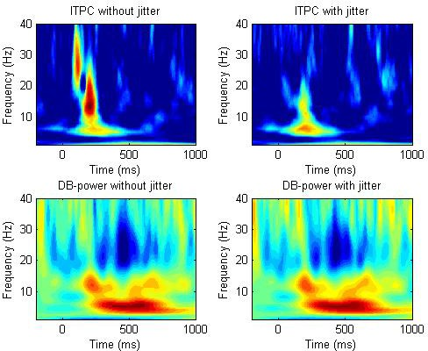
ITPC-Temporal Jitter
Most problematic when examining higher frequencies
consider monitor refresh rate
Notes:
ITPC reflects the precise timing of band-specific activity, it is sensitive to temporal jitter or temporal uncertainty of experiment events
Temporal jitter usually arises due to uncertanities in monitor display rate or time-locking to events due to uncertain onset times.
The negative impact becomes worse for higher frequencies because the cycle become shorter. Here is an example where we have introduced jitter in one ITPC and no jitter at the other.
You can see the effect of jitter in the ITPC as the higher frequencies are removed but the power is largely unaffected.
Therefore it is always a good idea to compare the timing of the experiment marker with the onset of the actual stimulus onset. The jitter is further compounded if you have the stimuli appearing at different locations of the monitor. So if there are unavoiable abd large temporal jitters in the temporal jitter, it is advisable not to analyse ITPC at high frequencies.

Slide 43
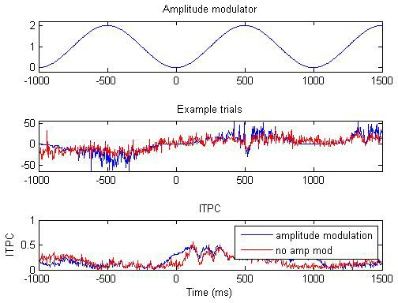
ITPC-Phase and Power
Phase is more influenced by power when power is low
– Check SNR or plot
When power is high, phase is independent of power
Notes:
Phase angles are independent of power except in very lower power.
With decreasing power, phase becomes difficult to estimate.
The figure shows the relationship between ITPC and power using real data. ITPC was computed over time for the original data and the data tapered with a 1-Hz sine wave with an amplitude fluctuation between 0 and 2.
This caused the data to fluctuate between 0 and double its original amplitude.The broadband ITPC shows difference between the unmodulated and modulated signals around times when the amplitude modulation was close to zero but seems otherwise intact, including when the amplitude was doubled.
So we can draw a conclusion that extreme signal attenuation can have an adverse effect on ITPC but signal enhancement had little effect.
We can concur that power and ITPC are not necessarily coupled and that ITPC can be safely interpreted independently of power except few cases.
It is a good idea to examine the relationship between ITPC and power in the data before confidently interpreting ITPC and power in different ways.
This could be done, for example, by showing qualitative differences between power and ITPC over time, frequency, electrodes, or conditions

Slide 44

Case Study
Notes:
Phase angles are independent of power except in very lower power.
With decreasing power, phase becomes difficult to estimate.
The figure shows the relationship between ITPC and power using real data. ITPC was computed over time for the original data and the data tapered with a 1-Hz sine wave with an amplitude fluctuation between 0 and 2.
This caused the data to fluctuate between 0 and double its original amplitude.The broadband ITPC shows difference between the unmodulated and modulated signals around times when the amplitude modulation was close to zero but seems otherwise intact, including when the amplitude was doubled.
So we can draw a conclusion that extreme signal attenuation can have an adverse effect on ITPC but signal enhancement had little effect.
We can concur that power and ITPC are not necessarily coupled and that ITPC can be safely interpreted independently of power except few cases.
It is a good idea to examine the relationship between ITPC and power in the data before confidently interpreting ITPC and power in different ways.
This could be done, for example, by showing qualitative differences between power and ITPC over time, frequency, electrodes, or conditions

Slide 45


Groups
Most animals and humans live within groups. Why?
A group can do things that individuals alone can't:
Augmented action capabilities: Members of a group can join forces to do something that is beyond the strength or endurance of a single individual
Increased sensing capabilities: A group has a much higher probability of finding resources and noticing danger
Increased cognition and intelligence: groups show emergent cognition and intelligent behaviours which are more powerful than those of the individual members.

Slide 46

Collaborative Decision Making
Power of crowds: groups have augmented wisdom. This is why human decisions are routinely made by committees (where members' knowledge, intelligence, experience and creativity are melded to improve outcomes).
Groups could fail: under- and over-confidence biases, reduced member effort, time constraints, strong leadership, …
Notes:
Group decisions are superior to individual decisions in many cases, not just thanks of more information, but also because tone of voice, facial expression, body language, eye contact, etc. unconsciously provide inner-state information.
The unconscious mind can be better than the conscious one in making decisions when many difficult alternatives are available, in assessing lack of truthfulness, etc.
If cBCI could tap into the unconscious minds of individuals without requiring verbal communication or body language, we could potentially build systems that benefit from the power of the unconscious mind without the biases mediated by explicit verbal and body language.

Slide 47
Collaborative BCIs (cBCIs)
Use data from multiple brains
First studies in the 2010s with simple perceptual tasks (faces/cars)
BCIs
Groups
Low accuracy
Leadership bias
Low speed
Time constraints
Collaborative BCIs
47

Slide 48

Our cBCI framework
Users report individual decisions
Brain signals used to decode the decision confidence of each participant
Group decisions made by weighing individual decisions according to the confidence estimates
48

Slide 49

Data recording and processing
EEG Data
(64 electrodes)
Stimulus-locked epoch
-0.2 s
Reference to earlobes
…
stimulus
+1.5 s
Band-pass filter
0.15-40 Hz
EOG correction
Response-locked epoch
Epoching
…
Baseline correction
-1 s
response
+0.5 s
49
BCI-NE Laboratory, University of Essex (UK)

Slide 50



Aggregating individual opinions
Confidence reported by the participants
Confidence decoded from the EEG
One head = One vote
50
Davide Valeriani

Slide 51



Dynamic, realistic environment
(video feeds, 4 FPS)
We used Unity3D to generate a dynamic environment where a soldier is walking along a corridor with multiple doorways present on both sides
Task: Decide whether the characters appearing wear a helmet or a cap
Helmet
Cap
Brightness increased by 40% for presentation purposes.

Slide 52

Your turn! Count the caps

Slide 53















Neural correlates of DM (TA1)
Existence of brain markers…
… for correctness
-400 ms
-120 ms
Response
+120 ms
Correct
Incorrect
Wilcoxon
Decision-Related Potential (DRP)

Slide 54

Neural correlates of DM (TA1)
Time Frequency Neural Correlates of Confidence
Average spectrograms across participants for correct and incorrect decisions
Late low-frequency (0-8 Hz) correlates of decision confidence
Early high-frequency (15-30 Hz) correlates of decision confidence

Slide 55

Outpost experiment
Outdoor environment, video feed but 10 FPS
The participant uses night vision to see a person walking towards the outpost
Task: decide whether the person is wearing a helmet or a cap
Provide a confidence estimation after the decision
Reward and penalties proportional to the correctness of the decision and the time taken by the user to respond (see next slide).
Does the cBCI work when you are under time-pressure?
Brightness increased by 40% for presentation purposes.

Slide 56
Incorporating Time Pressure
Reward system: The faster the response, the more points you score (for a correct response).
Reward
(if correct)
Penalty
(if wrong)
max
Brightness and contrast increased by 40% for presentation
Brightness increased by 40% for presentation purposes.
min

Slide 57


Similar but Weaker Neural Correlates
Response-locked epochs separated for correct and incorrect decisions

Slide 58

Neural correlates of DM (TA1)
Time Frequency Neural Correlates of Confidence
Similar results to the Corridor experiment
→ Low-frequency (0-8 Hz) and high-frequency (15-30 Hz) correlates of objective confidence were more frontal (FCz) than in the Corridor experiment

Slide 59

Neural correlates of DM (TA1)
Final Results
CSP features

